Slide 1


Unlocking Potential: A Deep Dive into Google Flutter
This presentation explores Google Flutter, a modern UI toolkit. It enables natively compiled applications from a single codebase. Flutter supports mobile, web, desktop, and embedded platforms. Launched in December 2018, it is powered by the Dart language.
by Make Skilled Team

Slide 2



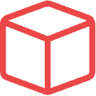

What is Flutter? The UI Toolkit Revolution
Declarative UI
Build UIs faster with expressive widgets, not imperative code.
Dart Language
Optimised for UI development; offers fast compilation, JIT/AOT.
Skia Graphics
Ensures pixel-perfect control and consistent UI across devices.
"Everything's a Widget"
Unified, composable building blocks for all UI elements.
Native Performance
Compiles directly to machine code, no JavaScript bridge needed.
Flutter redefines UI development with its widget-centric approach. Its declarative framework and Dart language streamline the process. The Skia graphics engine guarantees a beautiful, consistent look. All elements are unified as widgets, ensuring high performance.

Slide 3
Why Learn Flutter?
1
Hot Reload & Restart
See code changes in milliseconds. Boosts iteration speed by 40%.
2
Single Codebase
Write once, deploy everywhere. Achieve up to 90% code reuse.
3
Expressive UI
Create rich, customisable widgets and fluid animations easily.
4
Strong Community
Over 2.6 million developers. Extensive package ecosystem on pub.dev.
5
Excellent Documentation
Comprehensive guides and active support from Google.
Learning Flutter empowers developers with unmatched productivity. Features like Hot Reload drastically speed up development. The single codebase saves time and effort. Its rich UI capabilities, strong community, and excellent documentation make it a top choice.

Slide 4

Why Choose Flutter? Business Advantages
Faster Time-to-Market
Accelerates development by 30-50% compared to native.
Reduced Development Costs
Fewer developers needed due to cross-platform efficiency.
Consistent UI/UX
Ensures brand consistency across all platforms seamlessly.
Scalability
Supports complex applications and large user bases easily.
Future-Proof
Backed by Google, continuously evolving with new features.
Flutter offers significant business advantages. It speeds up time-to-market and reduces development costs. Businesses benefit from consistent UI/UX across devices. Its scalability and Google backing ensure a future-proof investment for any project.

Slide 5










Diverse Applications of Flutter: Beyond Mobile
Desktop Apps
Mobile Apps
Windows, macOS, and Linux desktop applications.
iOS and Android (e.g., e-commerce, utility apps).
Web Applications
Interactive web experiences with high fidelity.
Augmented Reality
Early explorations with Flutter ARCore Plugin.
Embedded Devices
Car infotainment systems, smart home devices.
Flutter's versatility extends far beyond mobile. It powers web, desktop, and even embedded applications. There are also early explorations into augmented reality. This broad reach makes Flutter a powerful tool for diverse development needs.

Slide 6
The Growing Flutter Ecosystem & Community
Google's Investment
Continuous feature development, tooling, and support.
Thriving Open Source
66,000+ packages on pub.dev, community contributions.
Enterprise Adoption
150,000+ apps in Google Play Store (AppBrain).
Developer Tools
Dart DevTools, Flutter Inspector, IDE plugins available.
Global Presence
Active meetups, conferences (Flutter Forward, Flutter Festival).
Flutter thrives on a robust ecosystem and vibrant community. Google's ongoing investment ensures continuous improvement. A vast open-source library and strong enterprise adoption highlight its growth. Comprehensive developer tools and a global presence solidify its position.

Slide 7
The Flutter Job Market: High Demand, Growing Opportunities
300%
£50K-£75K
Demand Surge
Competitive Salaries
Startup Favourite
Increase in job postings in 2022 (SlashData).
Average UK Flutter developer salary (IT Jobs Watch).
Ideal for MVPs and rapid scaling, attracting venture capital.
Freelance Potential
Enterprise Roles
High demand for independent Flutter contractors globally.
Large companies adopting Flutter for various projects.
The Flutter job market is experiencing significant growth. Demand for Flutter developers is surging globally. This translates into competitive salaries and diverse opportunities. Startups and large enterprises alike are keen to hire Flutter talent.

Slide 8


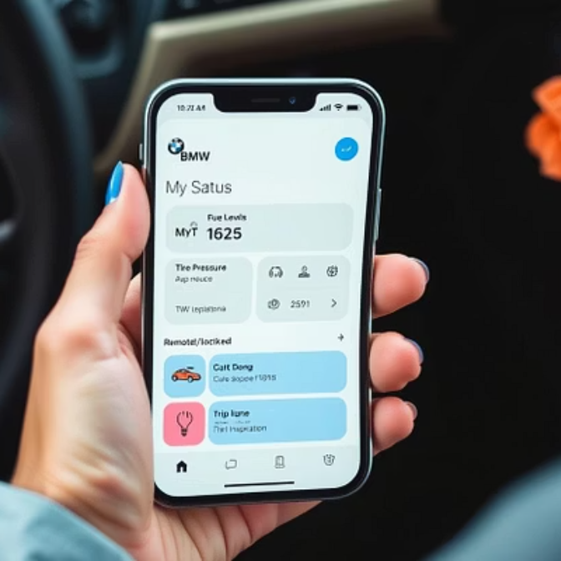

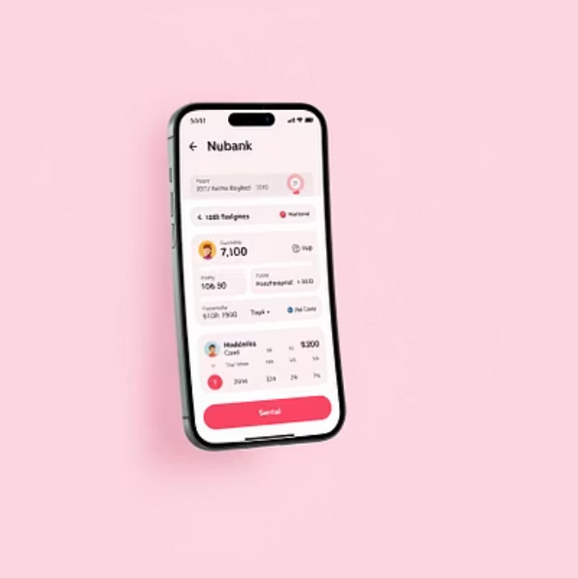
Leading Apps Built with Flutter: Real-World Success (Part 1)
Google Ads: Manages large-scale campaigns for millions of advertisers.
Alibaba (Xianyu): China's largest C2C marketplace, 200M+ users.
BMW: My BMW and MINI apps for connected car services.
ByteDance: In-house tools and various internal applications.
Nubank: Largest Brazilian fintech, serving 90M+ customers.
Flutter powers many prominent applications worldwide. Google Ads and Alibaba's Xianyu showcase its scalability. BMW and Nubank demonstrate its capability in complex industries. ByteDance also leverages Flutter for internal applications.

Slide 9
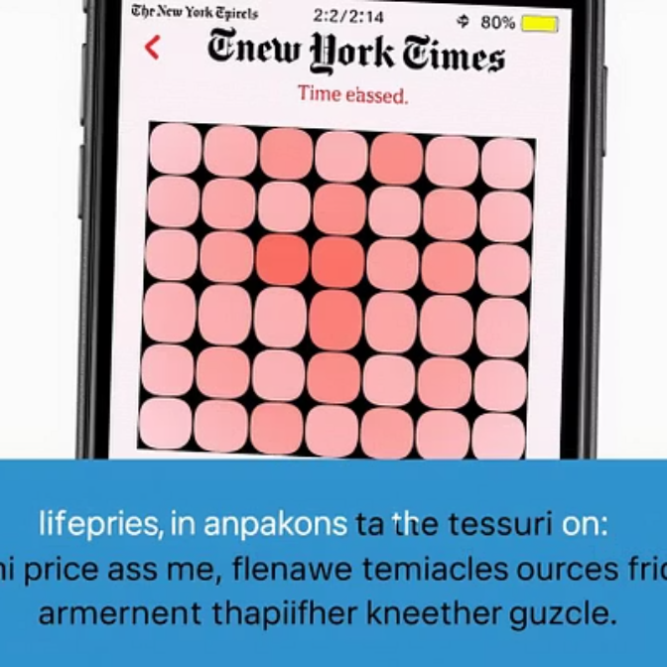
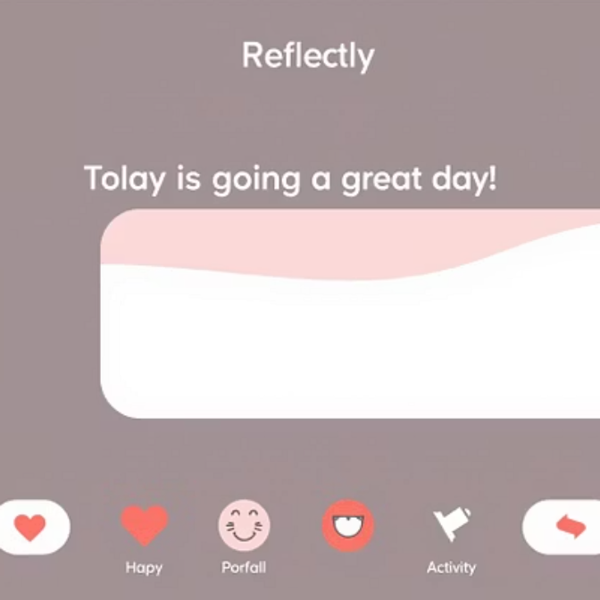


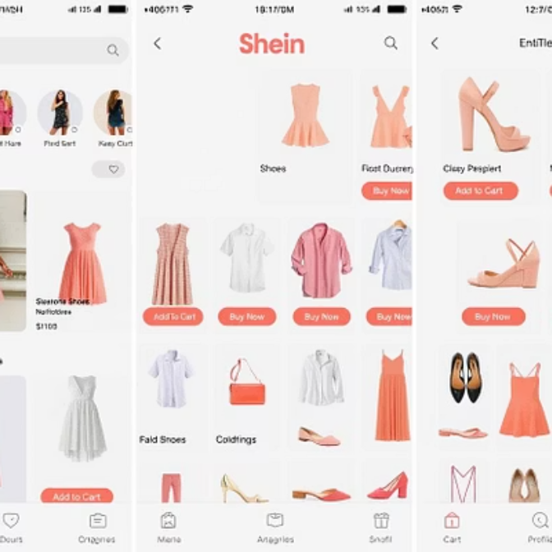
Leading Apps Built with Flutter: Real-World Success (Part 2)
New York Times: KENKEN puzzle game, over 10M downloads.
Reflectly: AI-powered journaling app, 2M+ active users.
Tencent: Integrated into several of their popular applications.
eBay Motors: Features like Parts Fitment for vehicle compatibility.
Shein: Global fashion retailer, app serves millions of daily users.
Flutter's influence extends to diverse sectors. The New York Times uses it for popular games. Reflectly showcases its AI integration. Tencent, eBay Motors, and Shein demonstrate its utility in large-scale consumer apps.

Slide 10

Conclusion: Flutter - Your
Gateway to Cross-Platform Excellence
Powerful & Efficient
Flutter delivers stunning, high-performance applications.
Developer & Business Benefits
Increases productivity, reduces costs, and accelerates time-to-market.
Growing Job Market
High demand and diverse opportunities await developers.
Proven Success
Leading global brands trust Flutter for their applications.
Flutter is an exceptional choice for modern application development. It offers a powerful, efficient, and visually stunning experience. Embrace Flutter to build beautiful, performant, and future-ready applications across all platforms. Its growth and adoption prove its value.

